Slide 1
Quantifying Understanding & Enhancing Relational Continuity of Care (QUERCC)
Tom Marshall
Fiona Scheibl
University of Birmingham

Slide 2
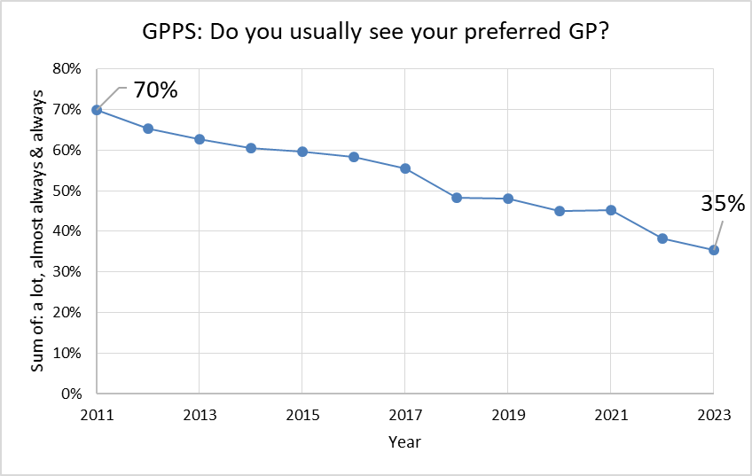
Relational continuity: the challenge
Preferred by patients
Preferred by doctors
More efficient
Better clinical outcomes
Declining

Slide 3
QUERCC: 5 work packages
Workshops: guidance on measuring continuity of care
Quantitative analysis: practice factors & continuity of care
Qualitative: in-depth case-studies in positive outliers
Economic analysis: effects of continuity of care
Workshops: practical guidance on optimising continuity of care

Slide 4
Relational continuity of care
More prior knowledge & trust
Reduced Hospitalisations
Reduced Consultation rates
Improved Prescribing
Better patient experience
Staff turnover
Internal practice policy / processes
Full time / part time clinicians
Practice size
Better clinical outcomes
Patient turnover
Patient case mix (age, sex, conditions)
Fresh perspective / second opinion
Burden on clinician
Effects on Access?
WP4: Economic analysis of effects of continuity
Positive effects
WP2: model predictors of continuity
WP1: continuity measurement
Negative effects
WP3: Case studies of practices
WP5: develop ways to improve continuity

Slide 5
WP1 Method
2 Stakeholder Workshops – 3 months apart
Clinicians, lay people and researchers
Coordinated by a professional facilitator & research team
Nominal Group Technique and coproduction methods
Small groups → cards of key ideas
Larger group → vote on key ideas
Final data synthesis across QUERCC
Consolidated Framework for Implementation Research
Normalisation Process Theory

Slide 6
Nominal group technique
Structured interaction: identifies consensus & divergence in priorities
Efficient when there is a range of perspectives & some groups more vocal than others [20]
Used widely in research
It is less resource intensive than alternatives (e.g. Delphi) and more likely to reach a clear outcome [22].
Helps bridge gap between lay & medical understanding of continuity

Slide 7
Sampling and recruitment workshop1
Purposive sampling using snowball methods
Brief email invitations sent out to key stakeholders
RF – made direct approaches to community patient facing groups to establish key contacts with community stakeholders in Birmingham (Heathwatch / SOS education / community connections)
TM – used clinical and academic networks & social media placing call for participants

Slide 8
Sampling and recruitment
Purposive sampling using snowball methods

Slide 9
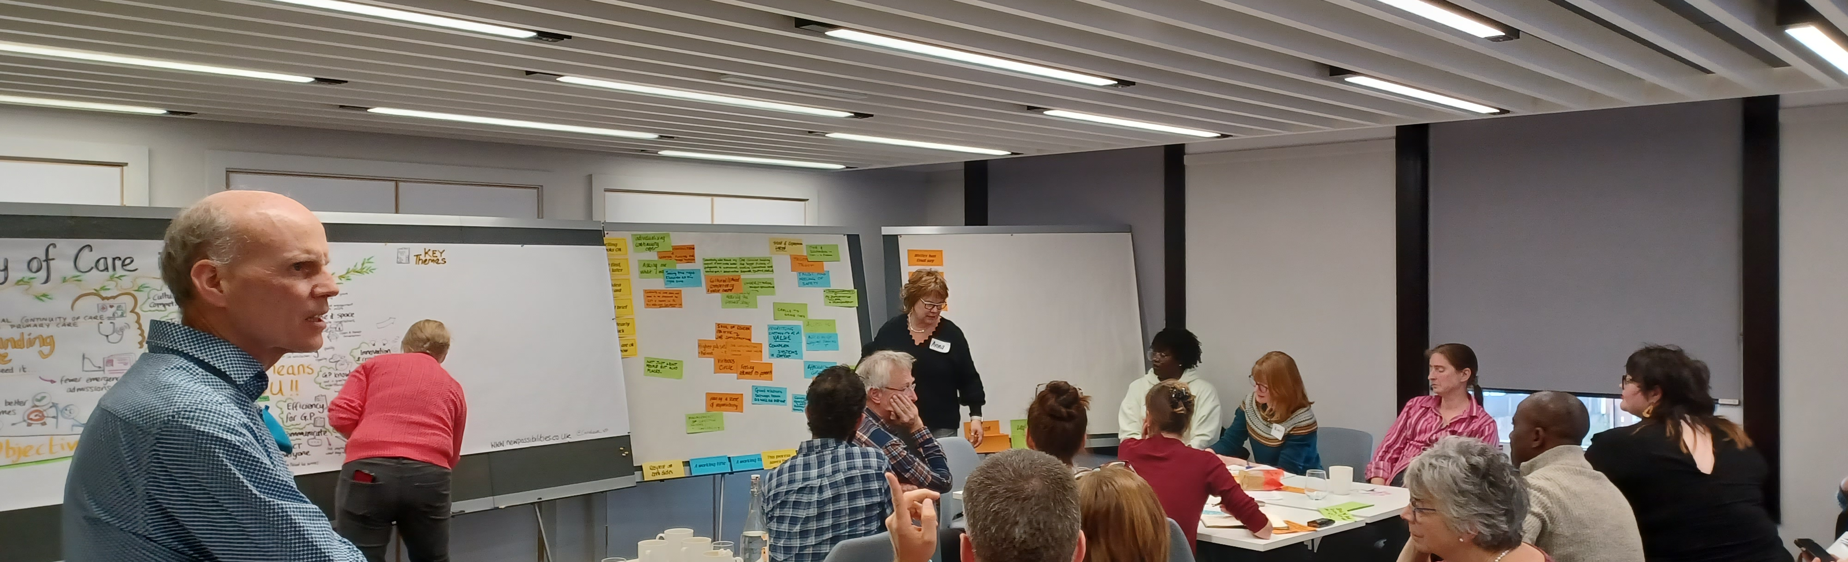
Workshop: November 2023
28 participants: 10 lay, 10 clinicians & 8 researchers
Age range: 16 to 65+
Majority White female. Asian, Black & Chinese participants
Four participants identified as having a disability

Slide 10
Patients, clinicians and researchers produced 3 cards with core ideas on RCC

Slide 11
Selected card clusters: Patients
“In an ideal world I would see the same person. That same person would have your notes. That same person would be patient and understanding. Digitalisation of forms save time and energy for everyone.”
“Need boundaries for all parties. Acknowledging and listening to self -diagnosis within reason. Somebody who knows my history - health and social - so I do not need to repeat complicated history each time. I want an individualised approach -for those who need the same GP and those who do not (neuro-divergent /chronic care/ mental health)”
“Someone who is present in the moment and not staring at the computer screen somebody with what I feel safe and knows me well enough not to label me as 'worried' 'well or difficult.”

Slide 12
Selected card clusters: Clinicians
Interprofessional knowledge often long-term, ease safety and efficiency of clinical tasks and management.
Time and space for open and honest conversation
Understand the context makes decision making easier
Soul of general practice

Slide 13
Selected card clusters: Researchers
Prioritise efficiency
Emotional intelligence see the same person
Trust
Reduced mortality
Coherent care

Slide 14
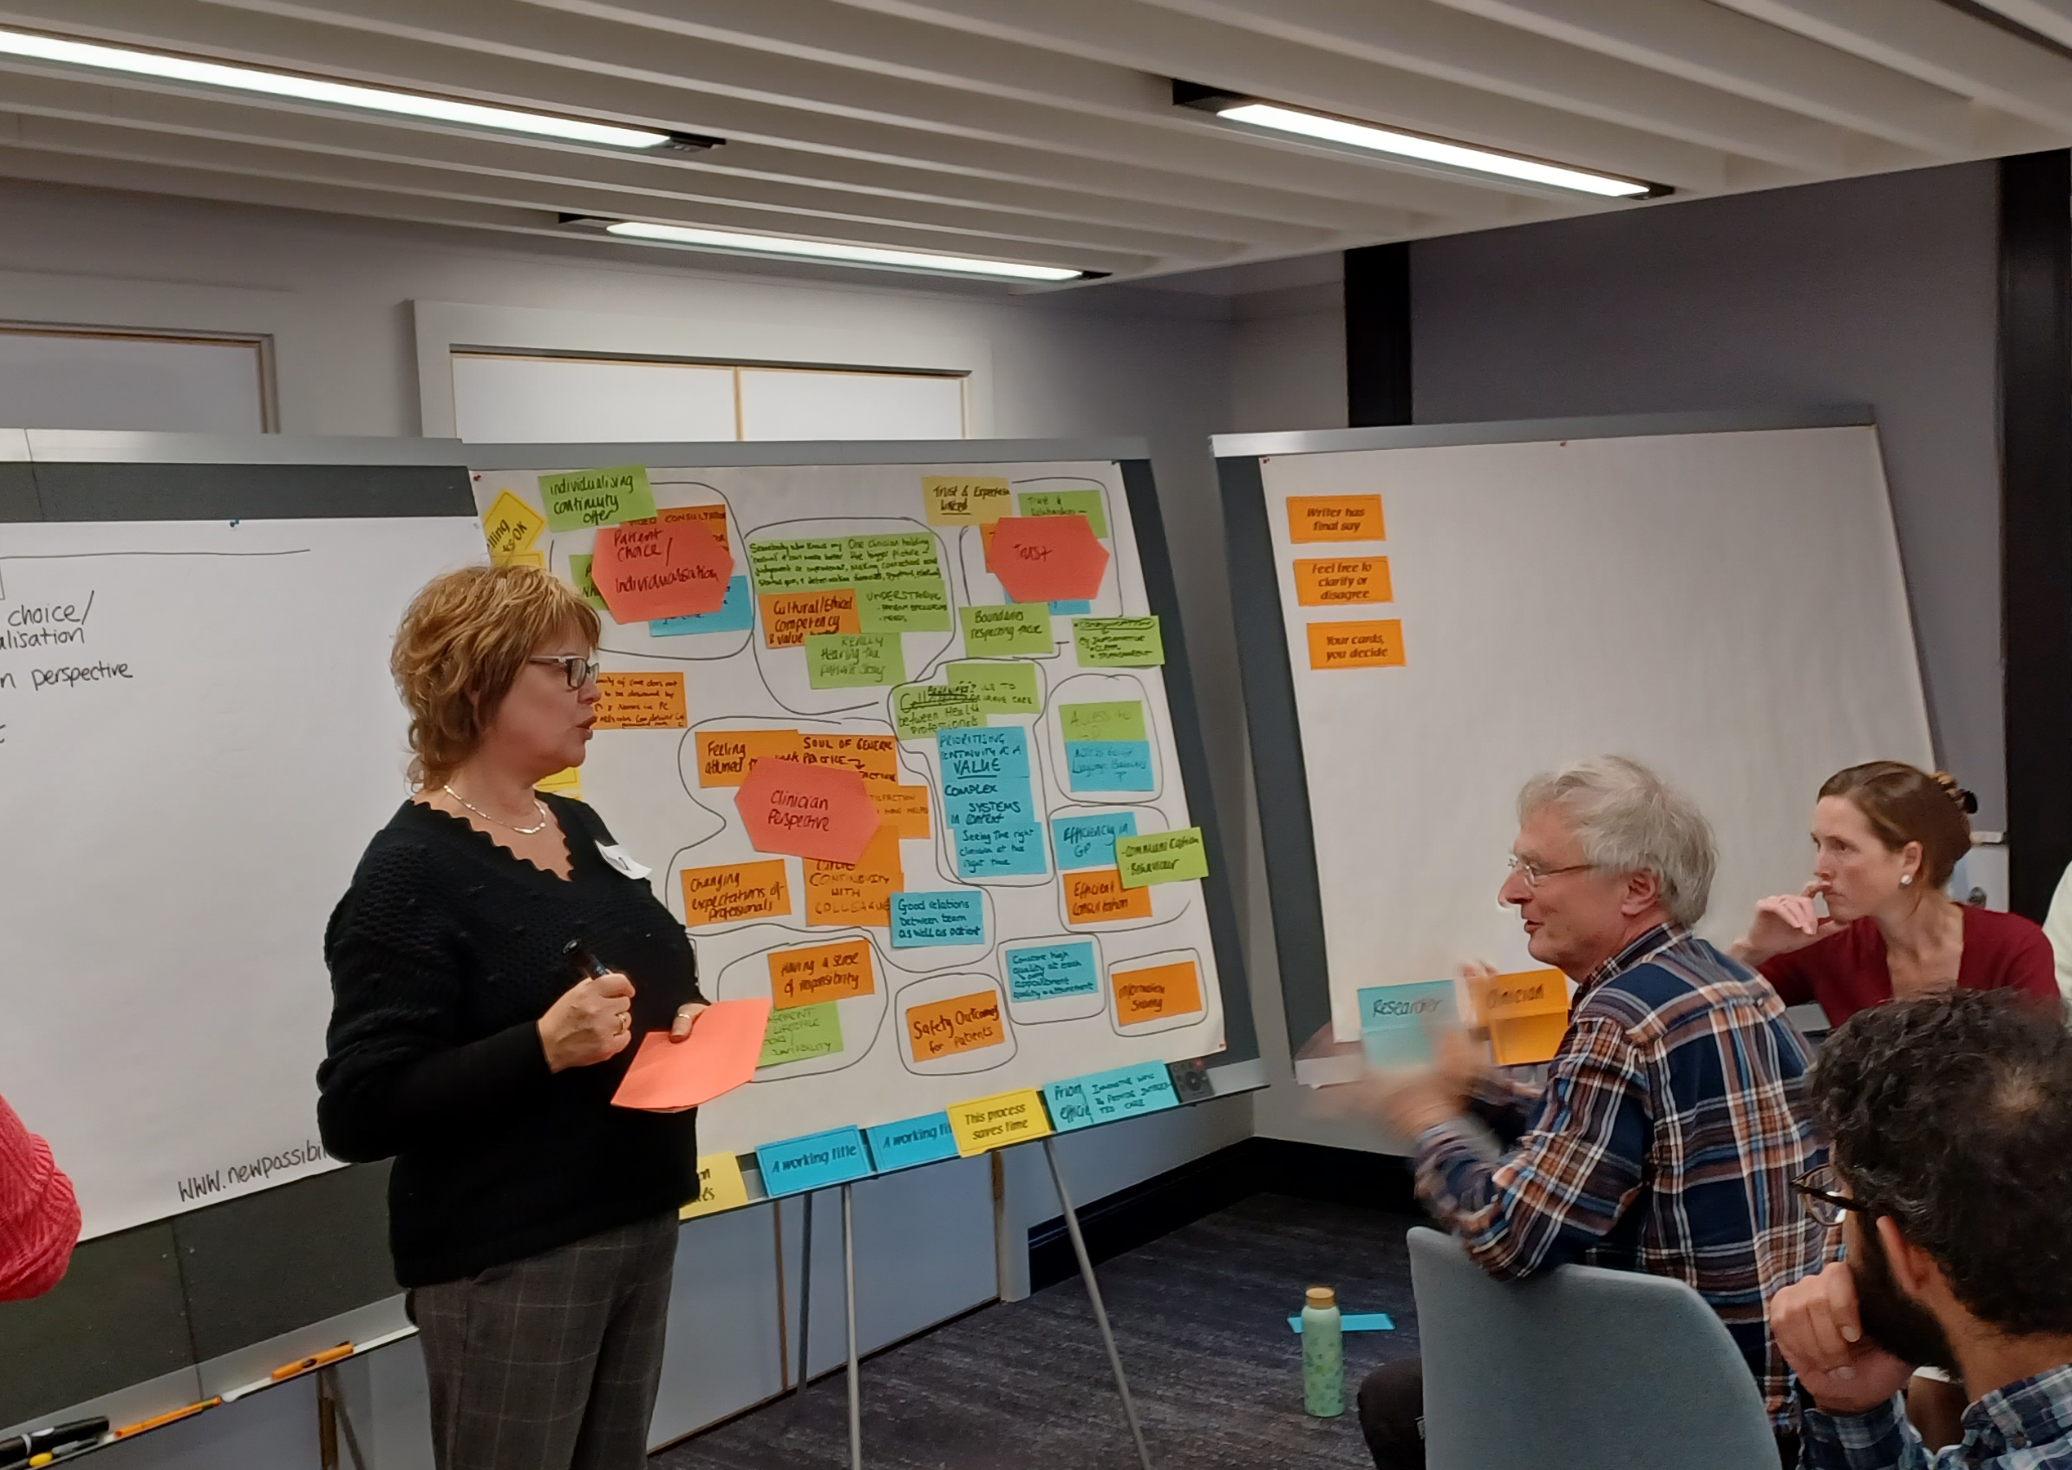
Ten thematic components
Context (15)
Patient Choice/ individualisation (11)
Familiarity (12)
Trust (10)
Efficiency (7)
Clinicians’ perspective (6)
Access (6)
Shared responsibility (3)
Quality & safety (2)
Location (2)

Slide 16
Conclusions
High degree of engagement & interest in the topic
Successful method
Themes broadly align with Nowak et al 2017 (systematic review of qualitative research into continuity of care)
Overlapping experiences of patients, physicians & researchers perspectives
Did not mention some of drawbacks mentioned Nowak

Slide 17
Thanks to
Fiona Scheibl
Kamil Sterniczuk
Iestyn Williams
Sheila Greenfield

